Slide 1

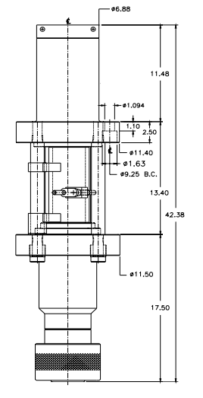
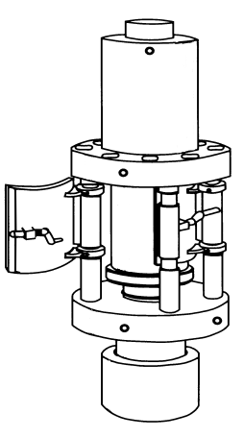
STRIPPER PACKER
Author: Jalal Alali
2018.05

Slide 2
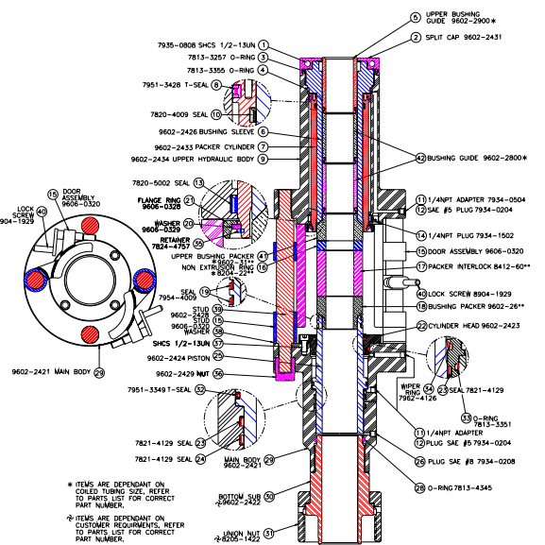

Slide 3
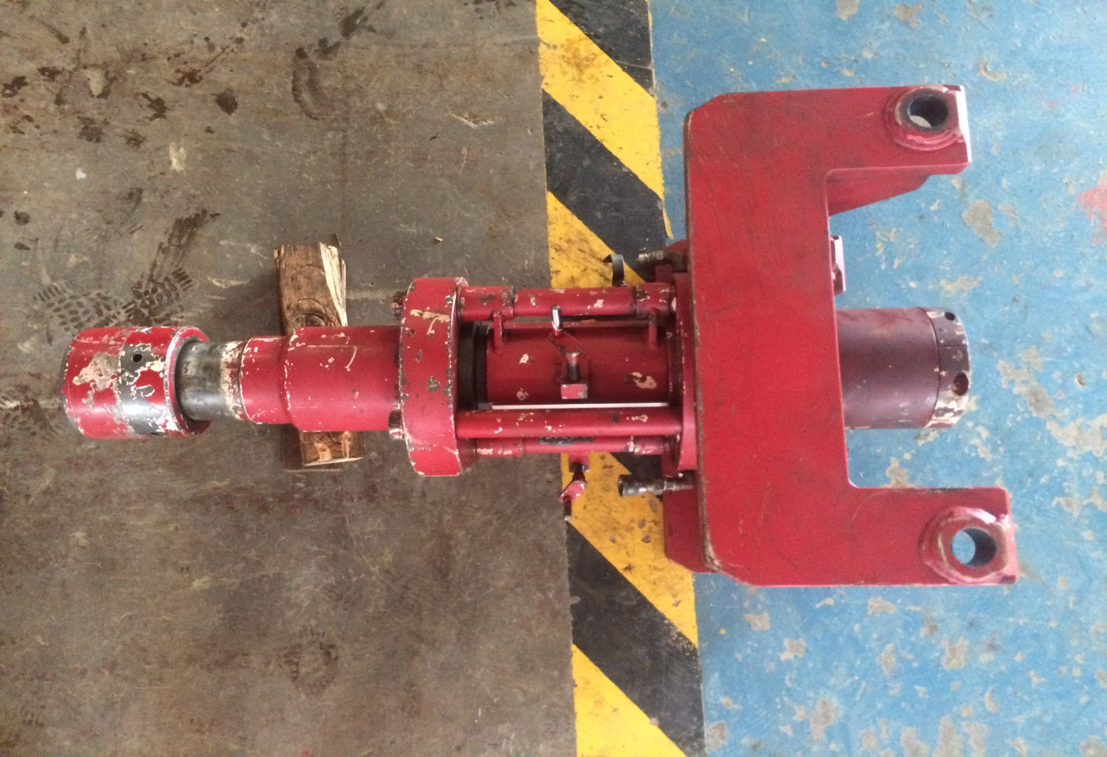

Slide 4
CONTENT
Introduction of Tool
Disassembly
Assembly

Slide 5
The Texas Oil Tools DSH Side Door Stripper Packer is the latest innovation of TOT’s commitment to coiled tubing technology. Like all of TOT’s side door models the packing elements and bushings can be replaced through the open door below the injector. Changing packers is easy through the side door even with tubing in the well. The DSH model has an increased open door length (7.0") to simplify the installation of hang-off slips that eliminates the need for a separate window. A threaded bottom connection allows convenient replacement in the event one is damaged or to change connections. Removal of the packers and bushings leaves a full 3.06" diameter through bore for passage of larger tools. The 3.06" DSH model can be installed in injector heads that conform to the 2.50" TOT side door stripper packers. Hydraulic pressure is required to open the packer cylinder exposing the packer, non-extrusion ring, and bushings. A manually operated packer cylinders also available. Please contact your local TOT sales representative for further information. The piston on the 3.06 DSH model is below the packer element. Having the piston in this position will decrease the amount of hydraulic pressure required to pack-off around the coiled tubing.
Introduction:

Slide 6
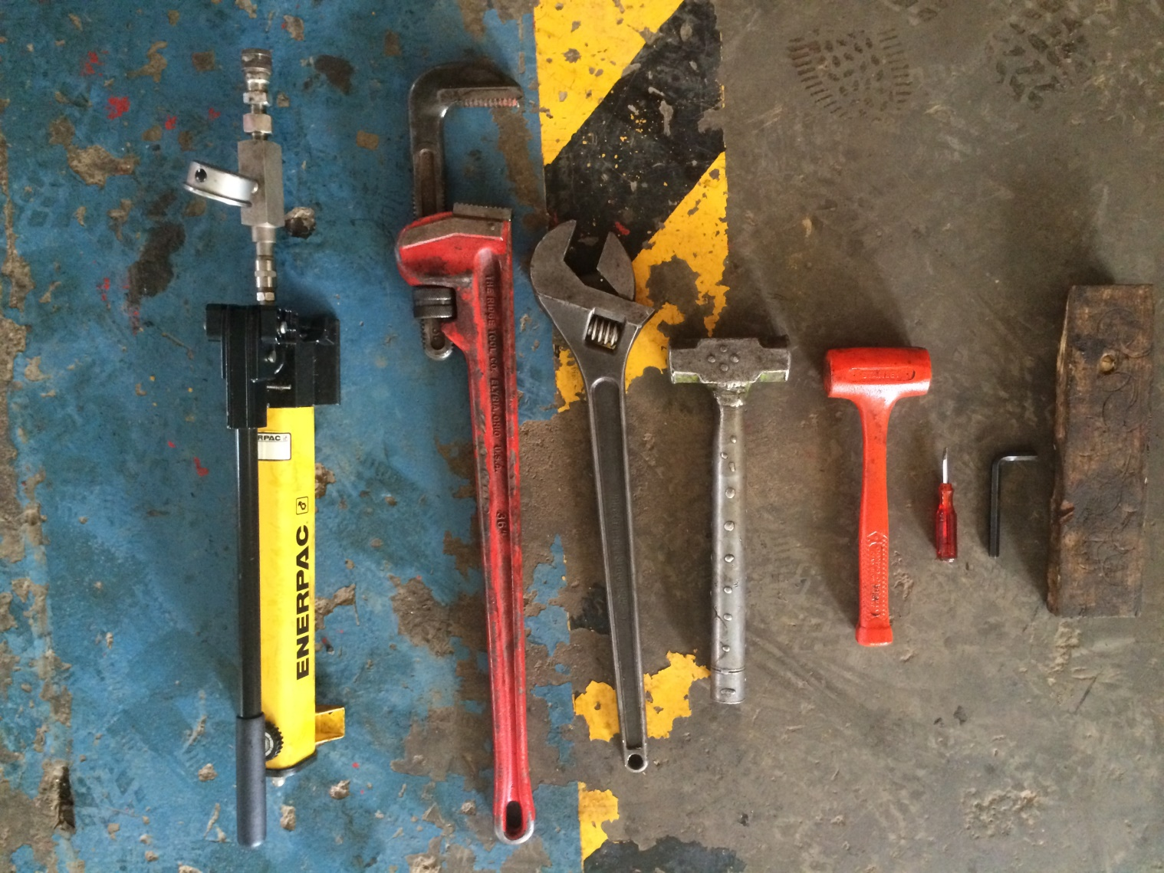
Required hand tools
Pipe Wrench
Screw driver
Special tool
Hammer (iron , plastic)
Allen key
Hydraulic hand pump

Slide 7
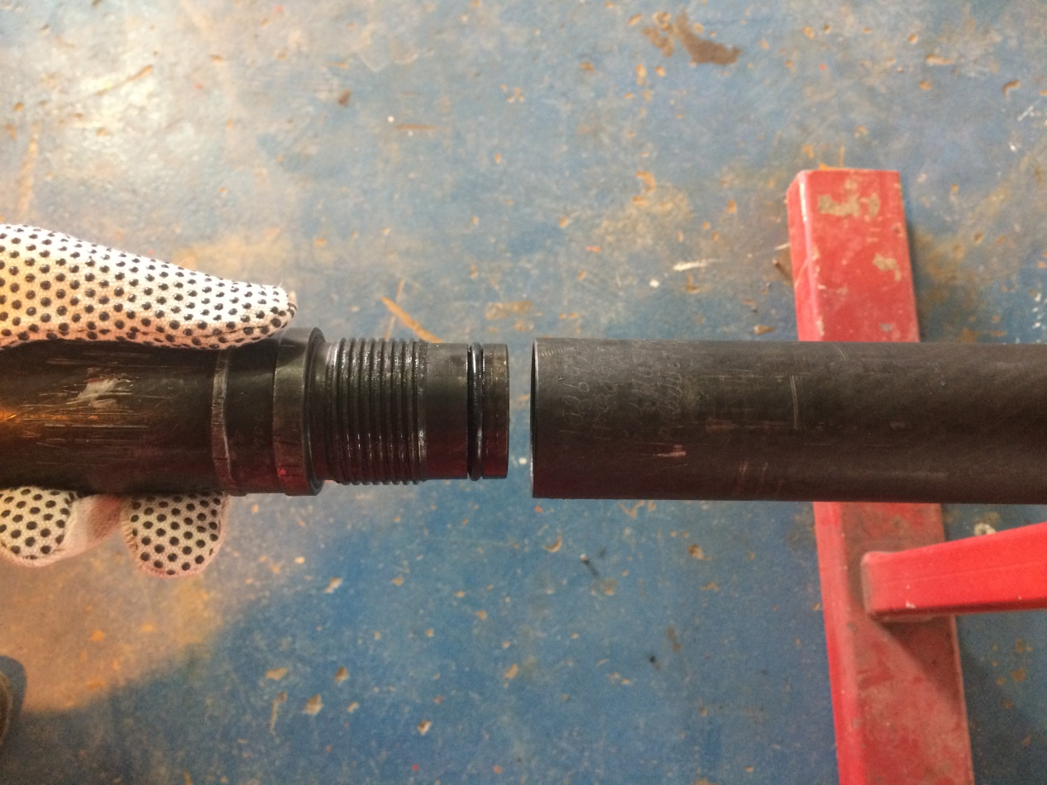
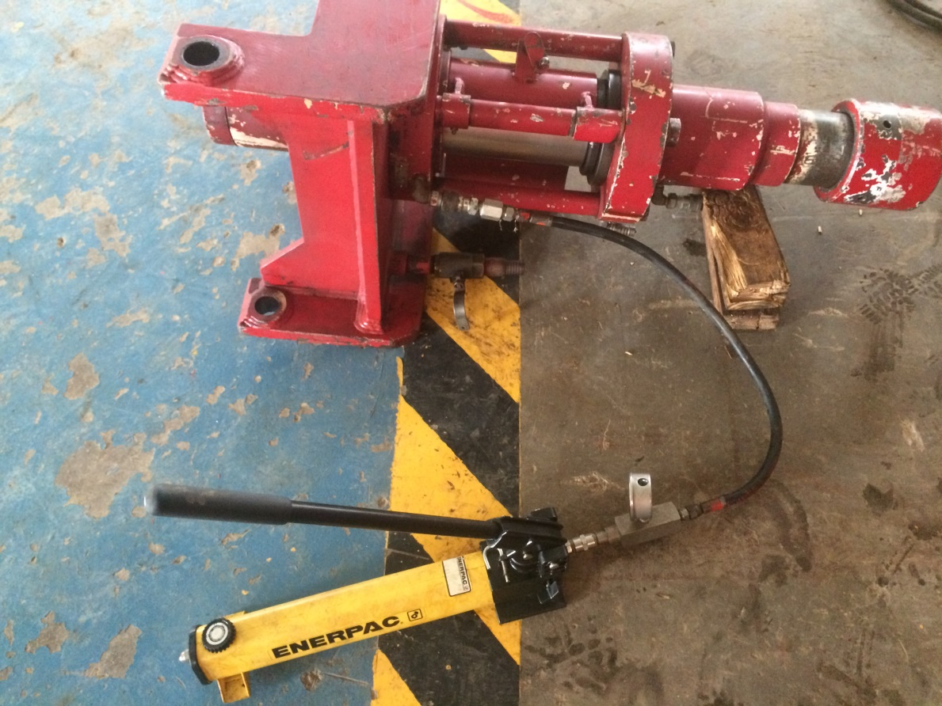
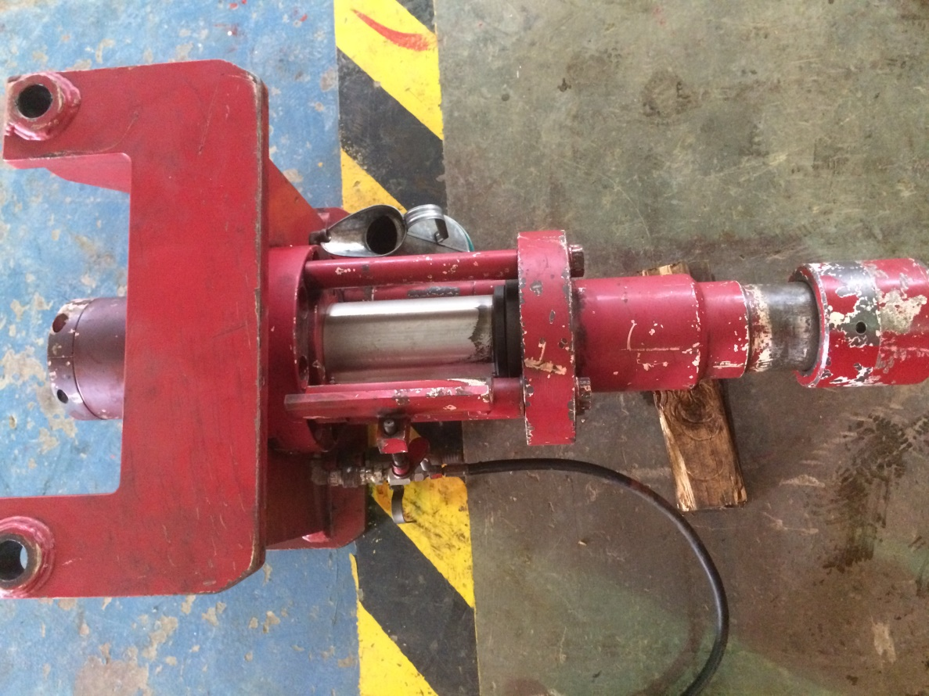
Disassembly
1- to change packers while mounted in the injector ( or using hydraulic hand pump ) retract the lock screw(40) , swing the guard door lock assemblies(15) to open position. Apply hydraulic pressure to the retract port located on the main body(29) to move the piston(15) to maximum downward position.
A
B

Slide 8
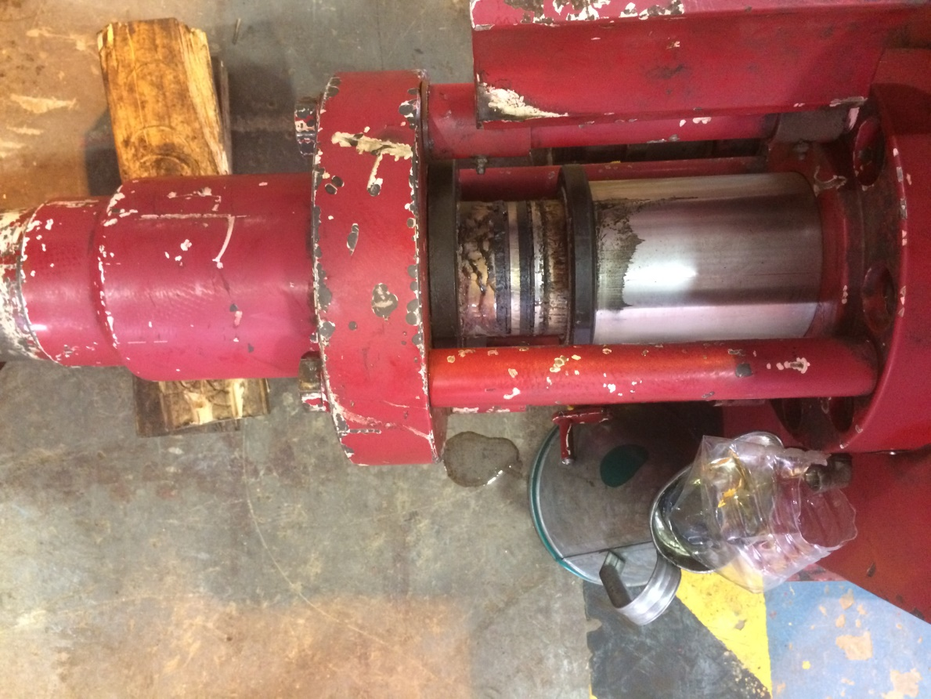
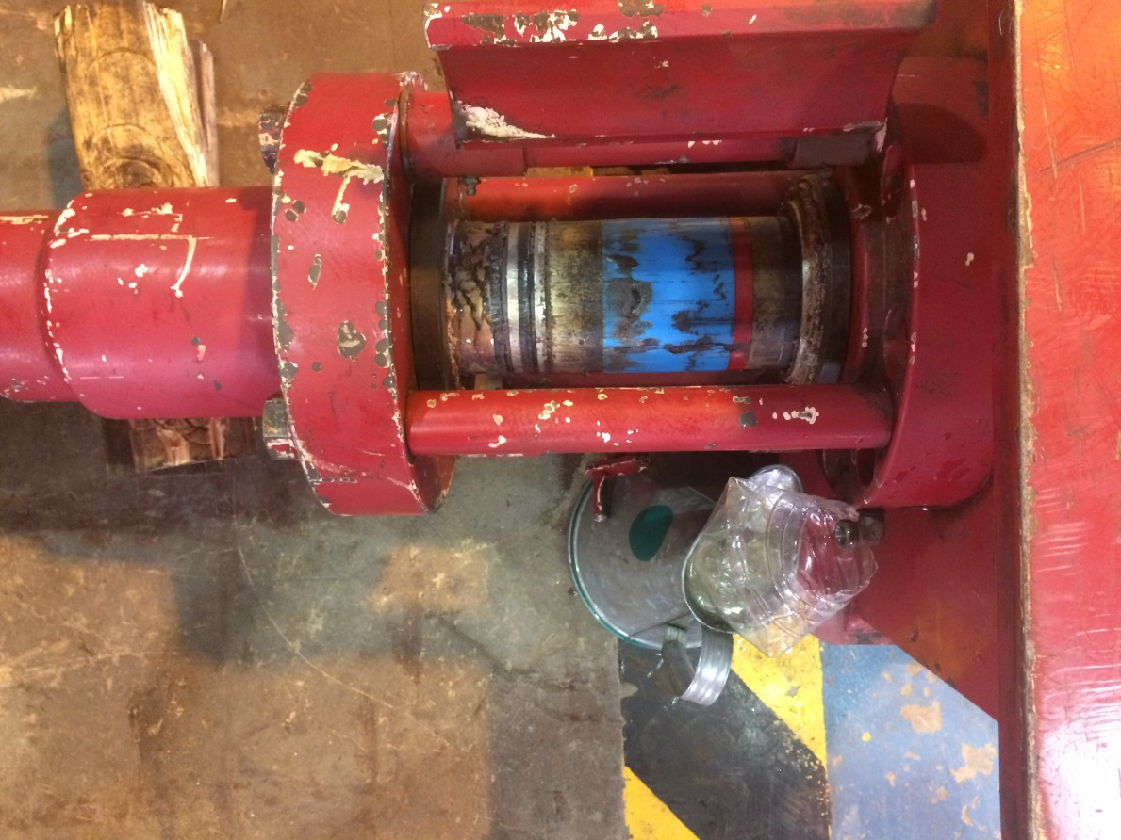
1- to change packers, retract the lock screw(40) , swing the guard door lock assemblies(15) to open position. Apply hydraulic pressure to the retract port located on the main body(29) to move the piston(15) to maximum downward position.
C
Guard lock door
D
Packer cylinder

Slide 9
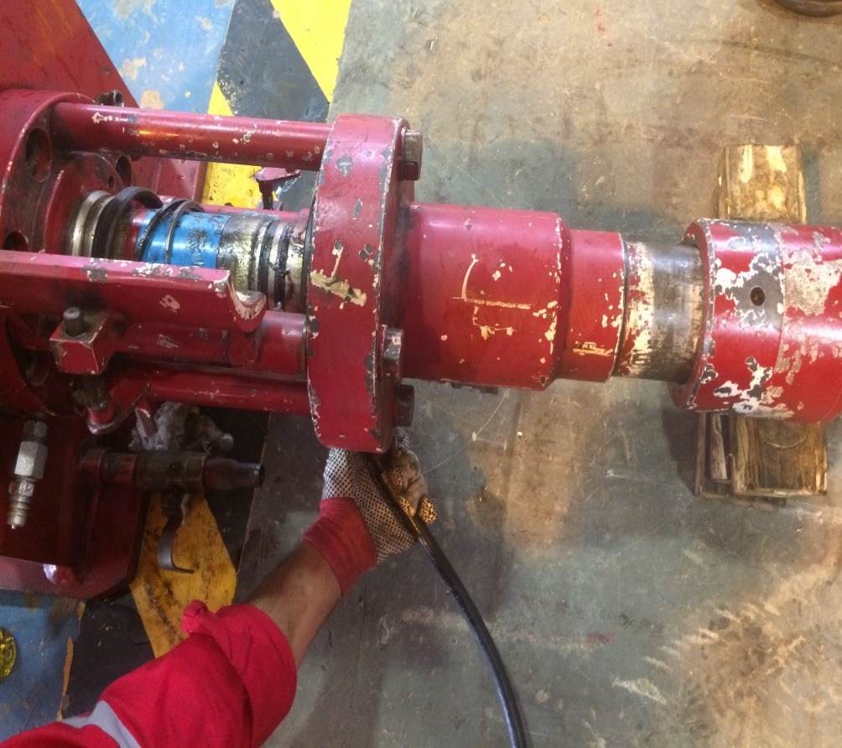
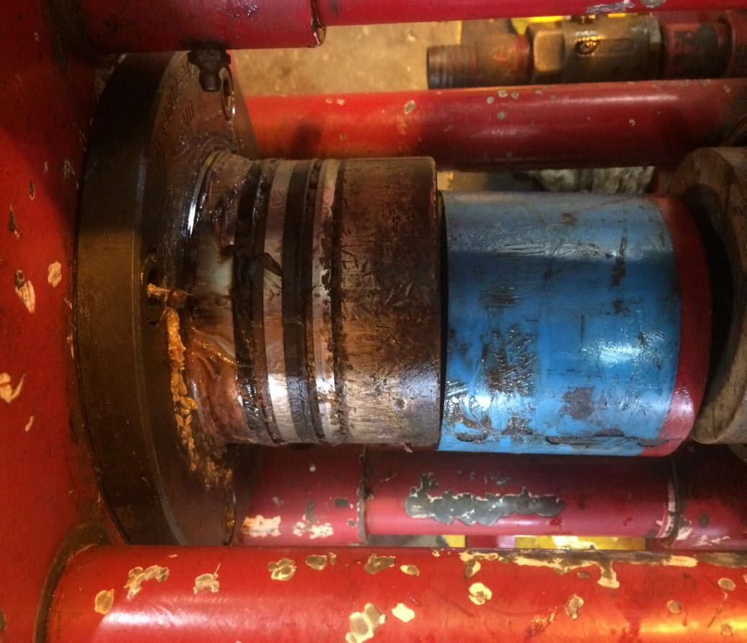
2- apply hydraulic pressure to the retract port located on the upper hydraulic body(9) to move the packer cylinder(7) to maximum upward position exposing the pack-off assembly , for removal of the packer interlock(17) , non-extrusion ring(16), and the lower packer bushing(18) .
Packer cylinder
Non-extrusion
B
A
Retract port (9)
Packer interlock

Slide 10
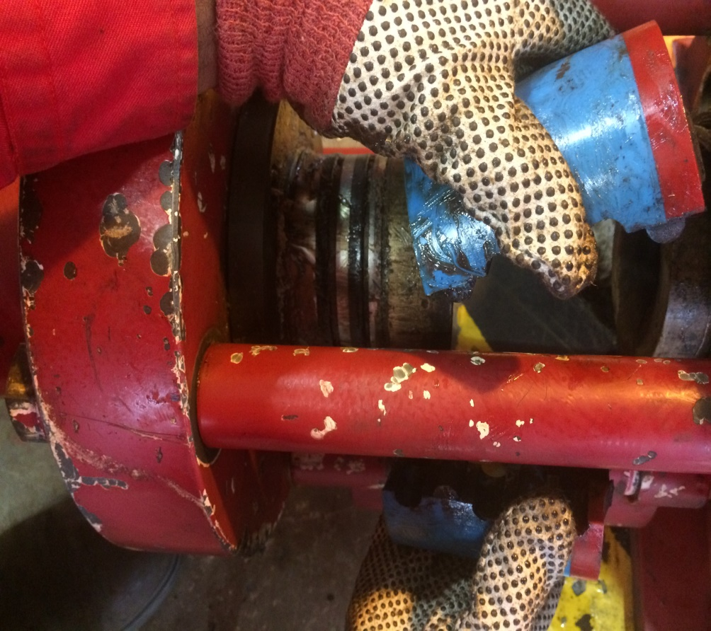
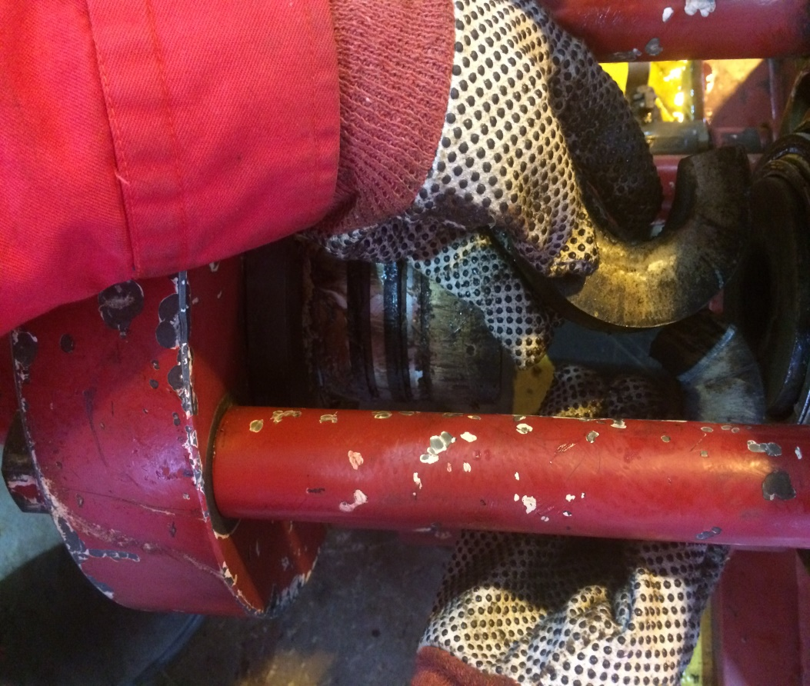
packer interlock
non-extrusion ring
C
D

Slide 11
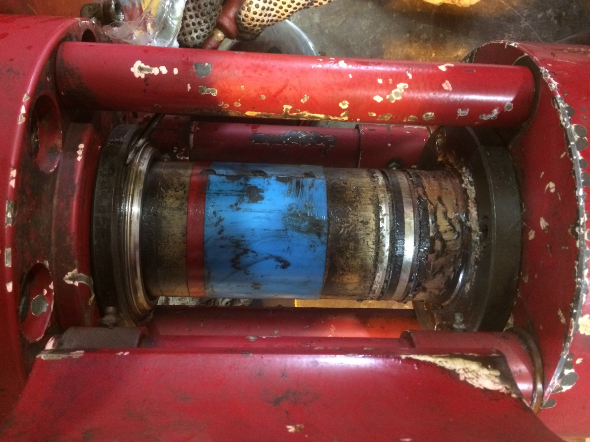
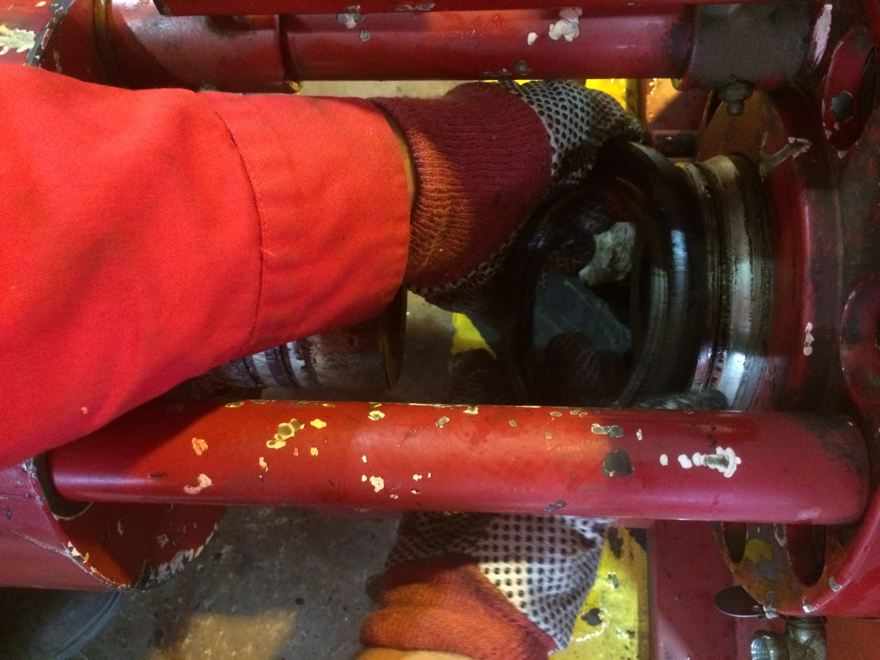
3- To replace all seals: drain all remaining hydraulic fluid from pack-off ports. Remove stripper packer from the injector. Remove retainer ring(35) , washer (20), and flange ring(21) from packer cylinder(7).
retainer ring , washer , and flange ring
A
B

Slide 12
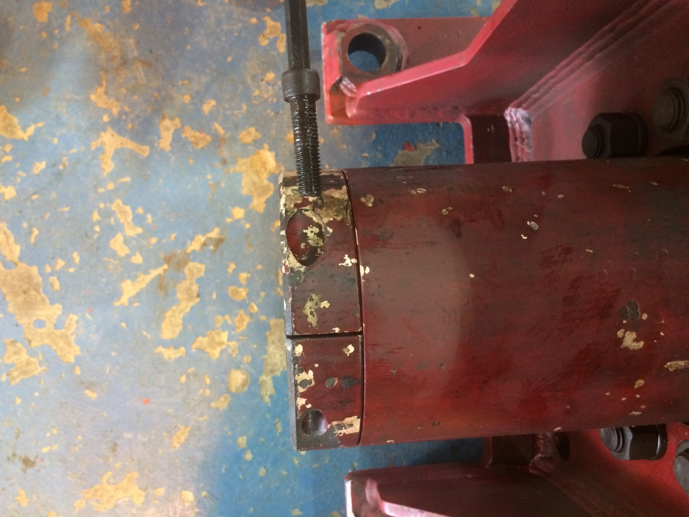
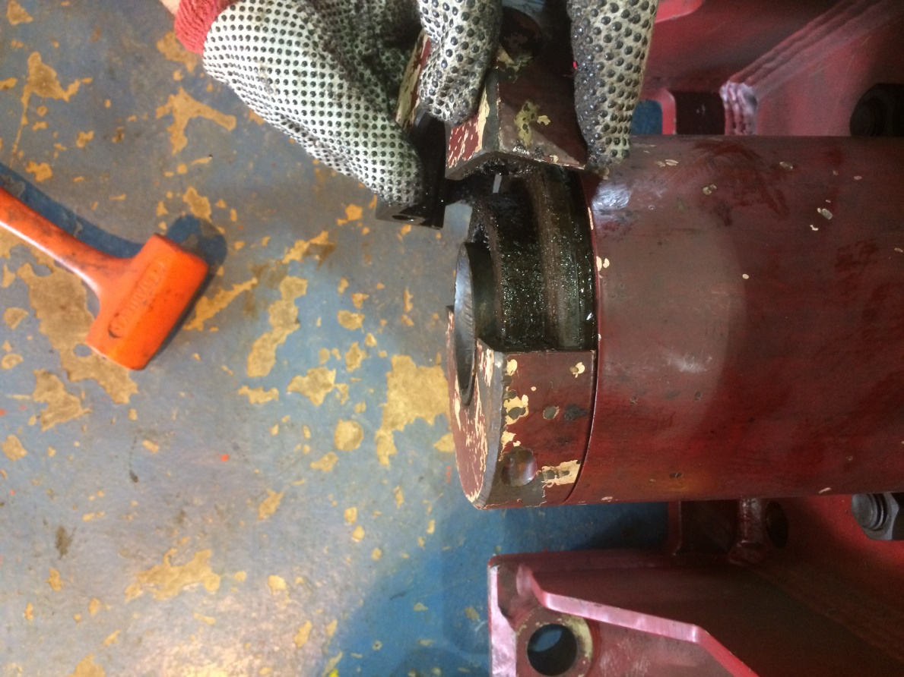
4- Remove two socket head cap screws ½ (1) , split cap(2), and unscrew bushing sleeve(6). Then , remove O-ring (3 and 4)
A
B
Split cap

Slide 13
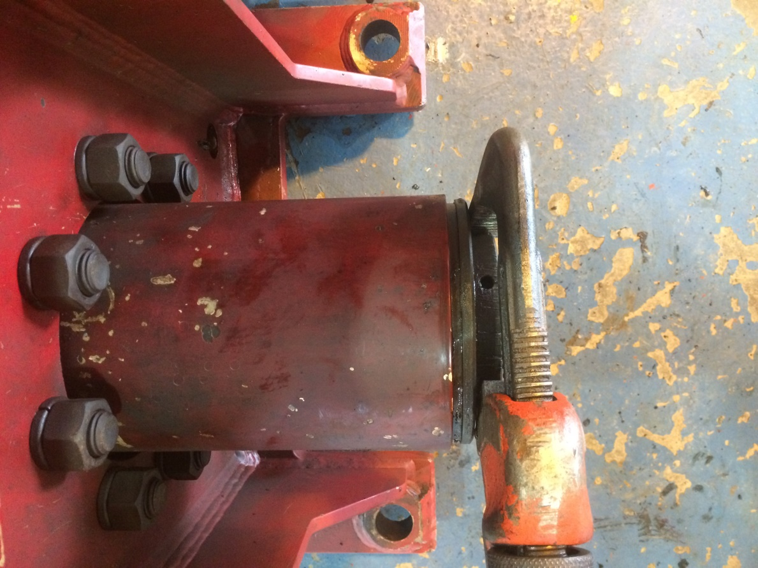
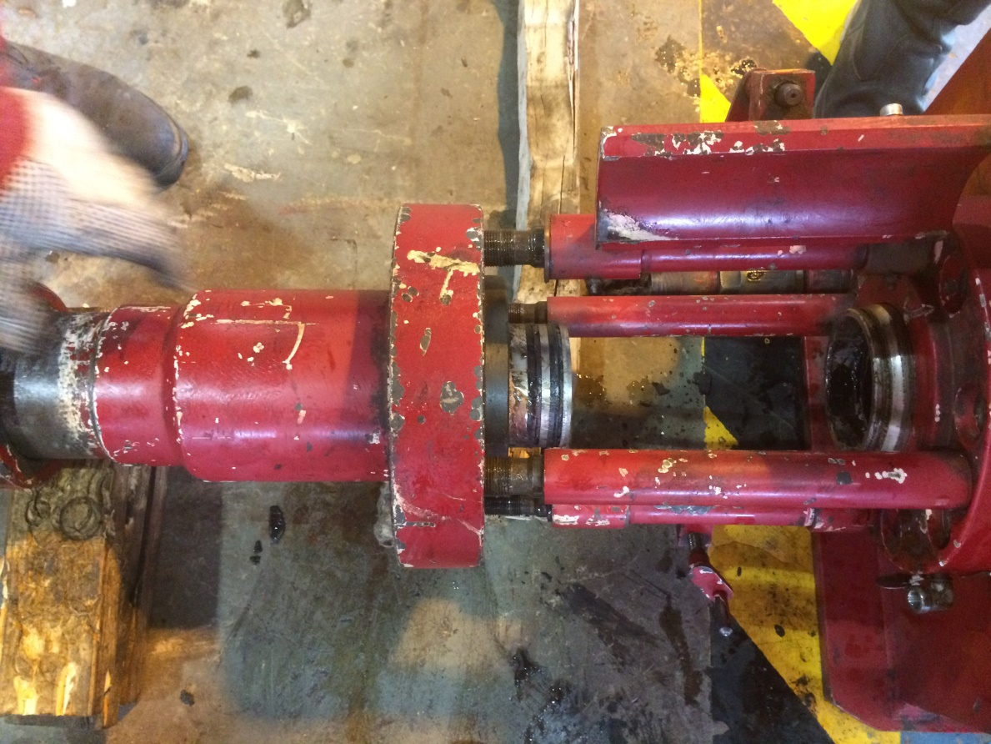
4- the packer cylinder must be removed from the top of the unit. The two ¼ (20) UNC holes in the top of the packer cylinder may help when removing. CAUTION : take care when removing the packer cylinder(7) as all I.D , and O.D surface are for sealing.
A
B
Upper bushing guide
Bottom sub

Slide 14
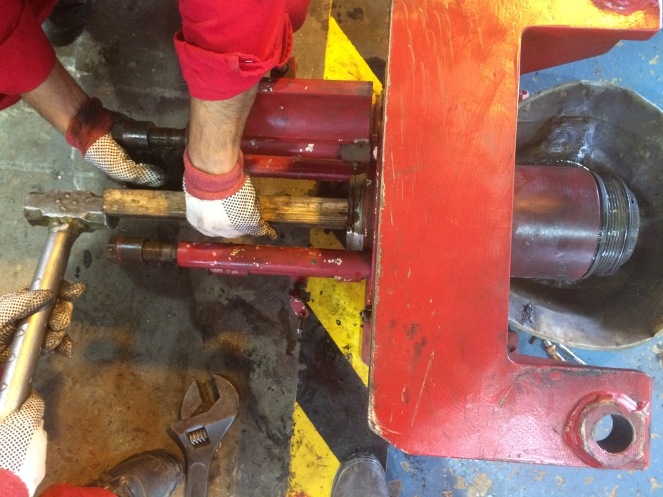
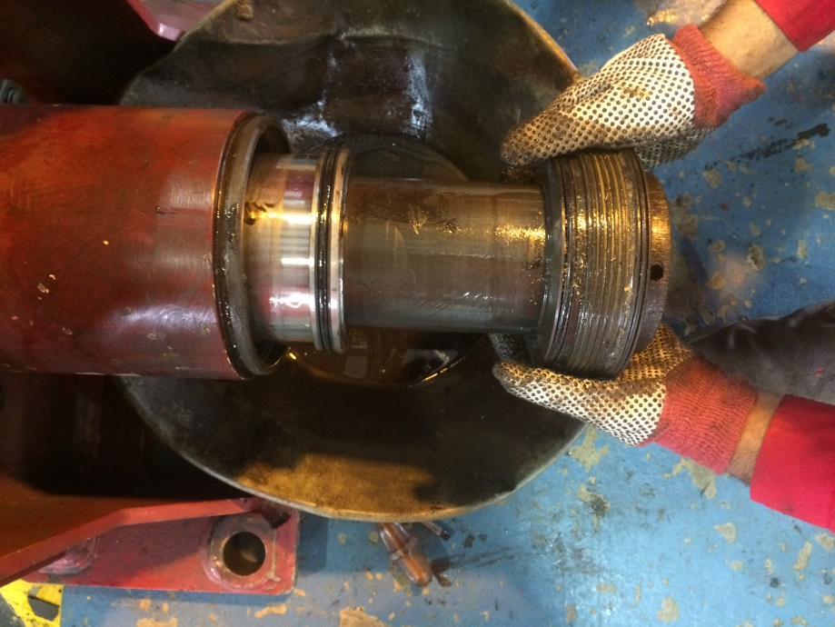
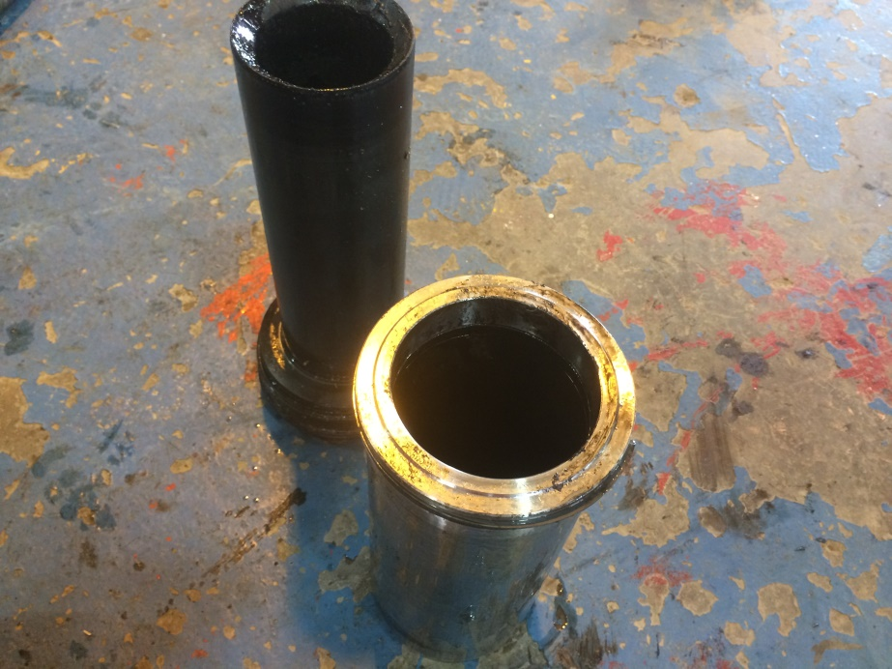
4- the packer cylinder must be removed from the top of the unit. The two ¼ (20) UNC holes in the top of the packer cylinder may help when removing. CAUTION : take care when removing the packer cylinder(7) as all I.D , and O.D surface are for sealing.
Bushing sleeve
Packer cylinder

Slide 15
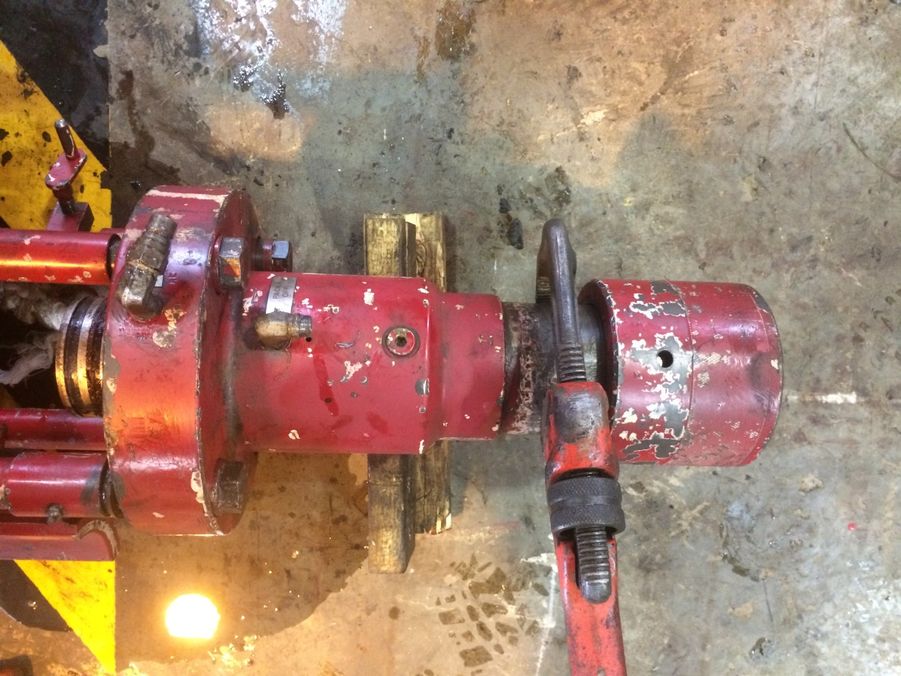
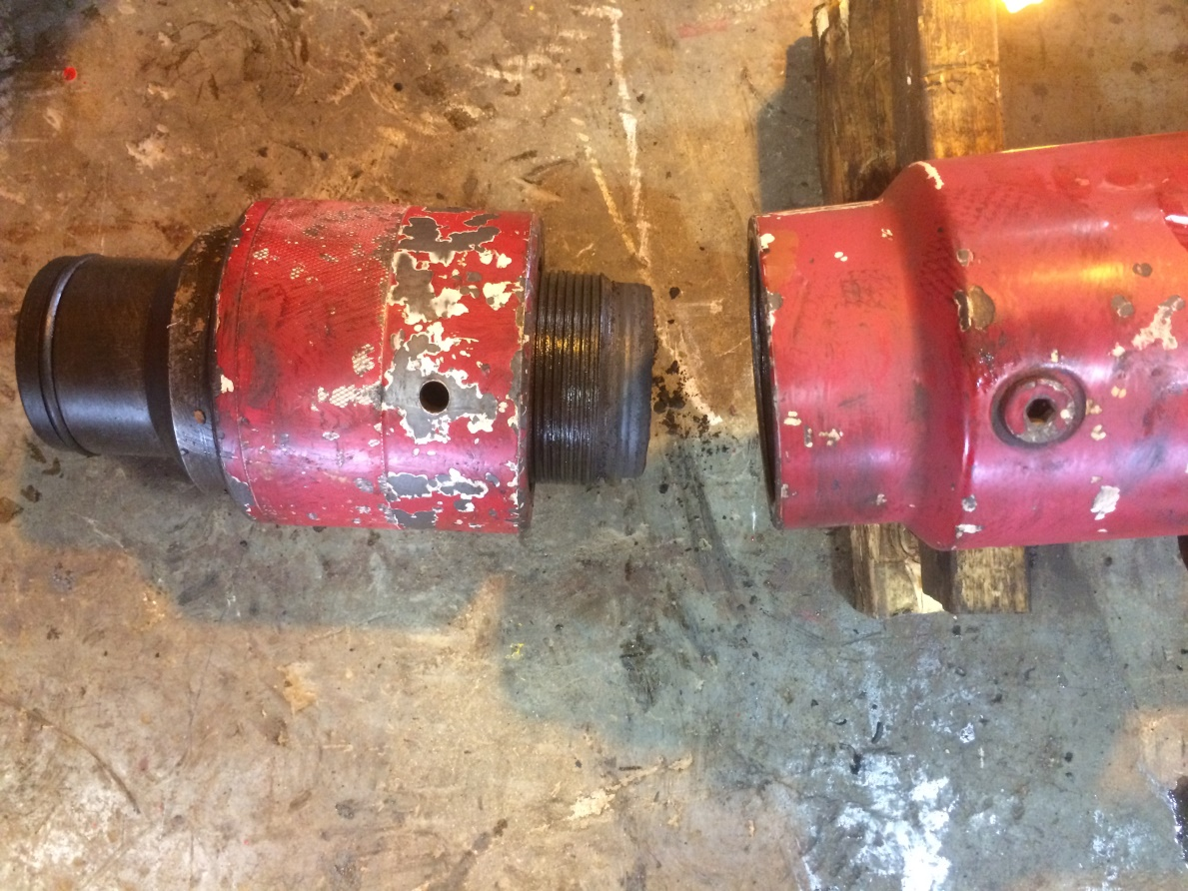
5- remove the bottom sub(30) by clamping on the main body(29) and turning counterclockwise. There is enough room on top of the union nut(31) to use a wrench. Remove the O-ring (28) .
A
B

Slide 16
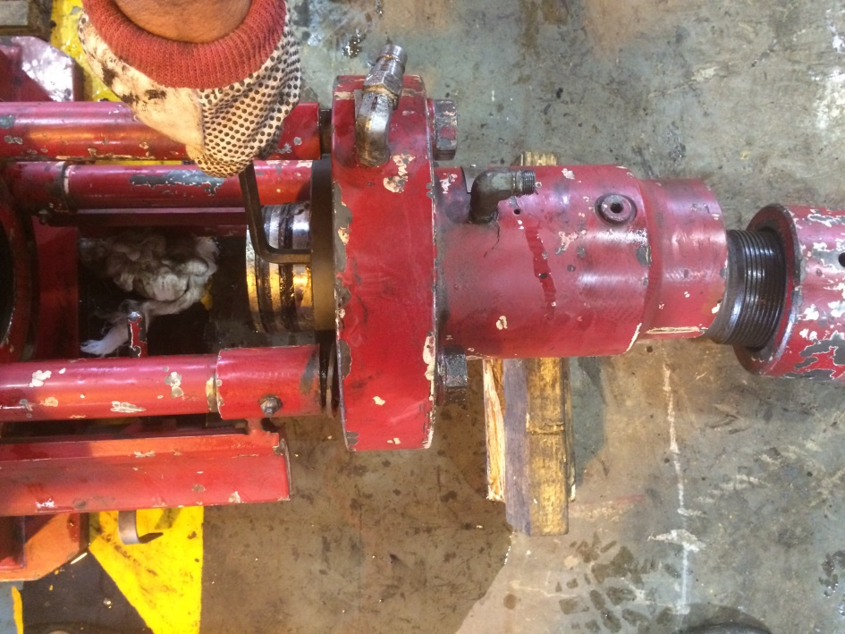
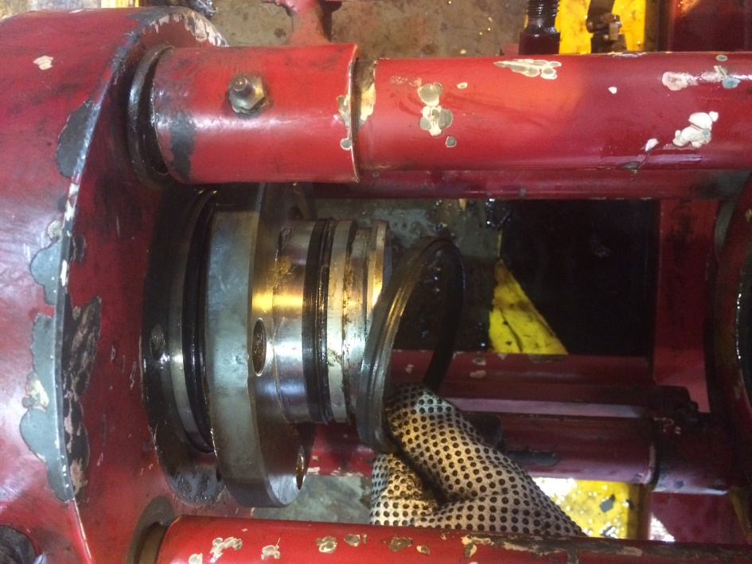
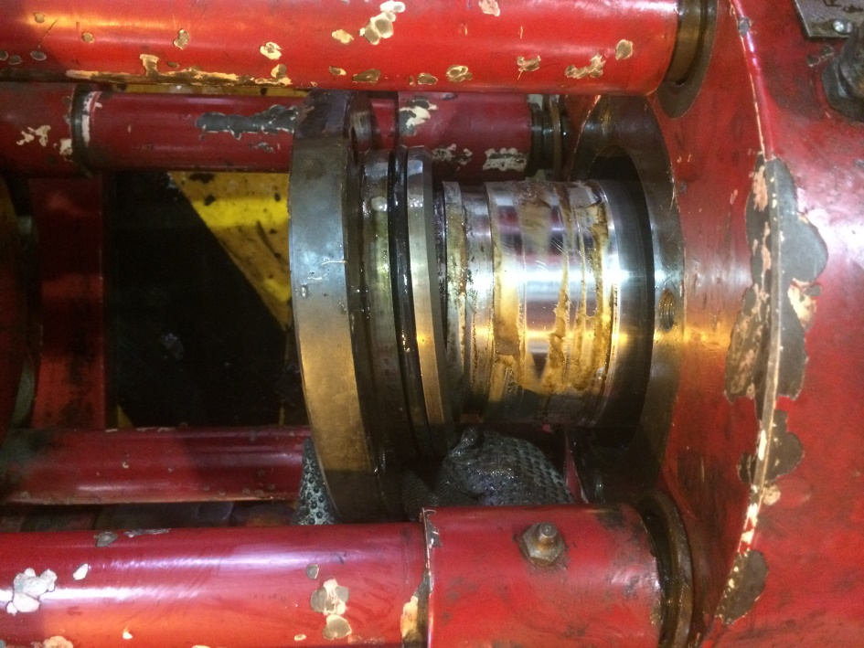
6- The next step is to remove the cylinder head(22). Begin by removing the ½ (13) socket head cap screws with a 3/8 Allen wrench. Remove the cylinder head (22). CAUTION : before this action at first remove the seals(19) .
seals(19)
A
cylinder head
B
C

Slide 17
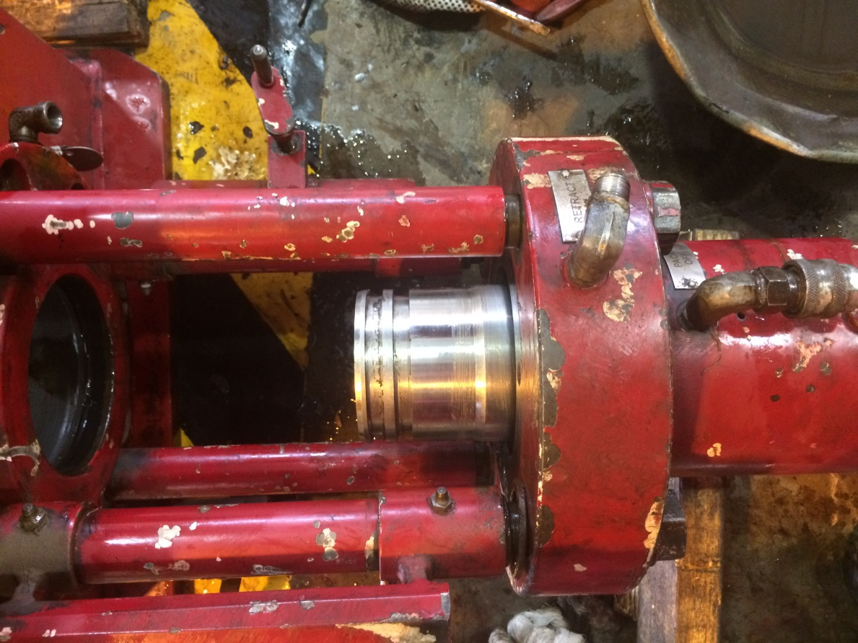
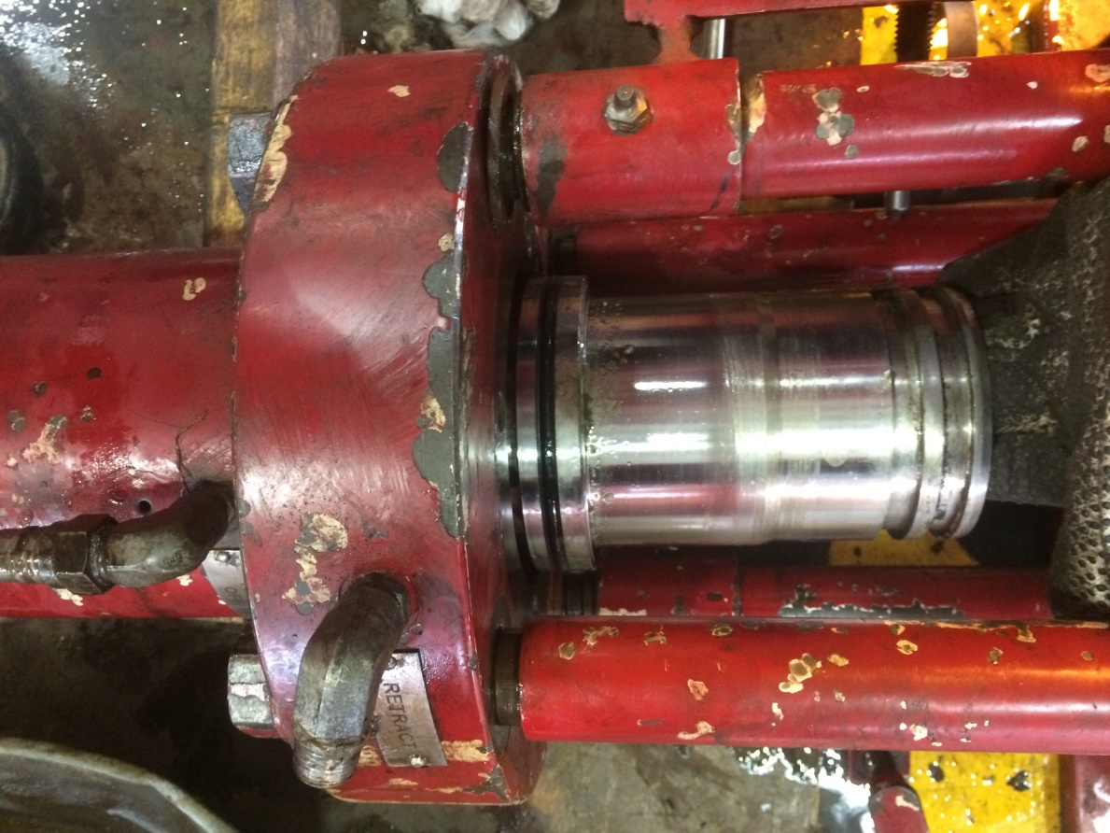
8- Remove the piston(25) by driving it out (with hydraulic and pump) . Be careful not to damage the sealing surfaces .
A
B
piston

Slide 18
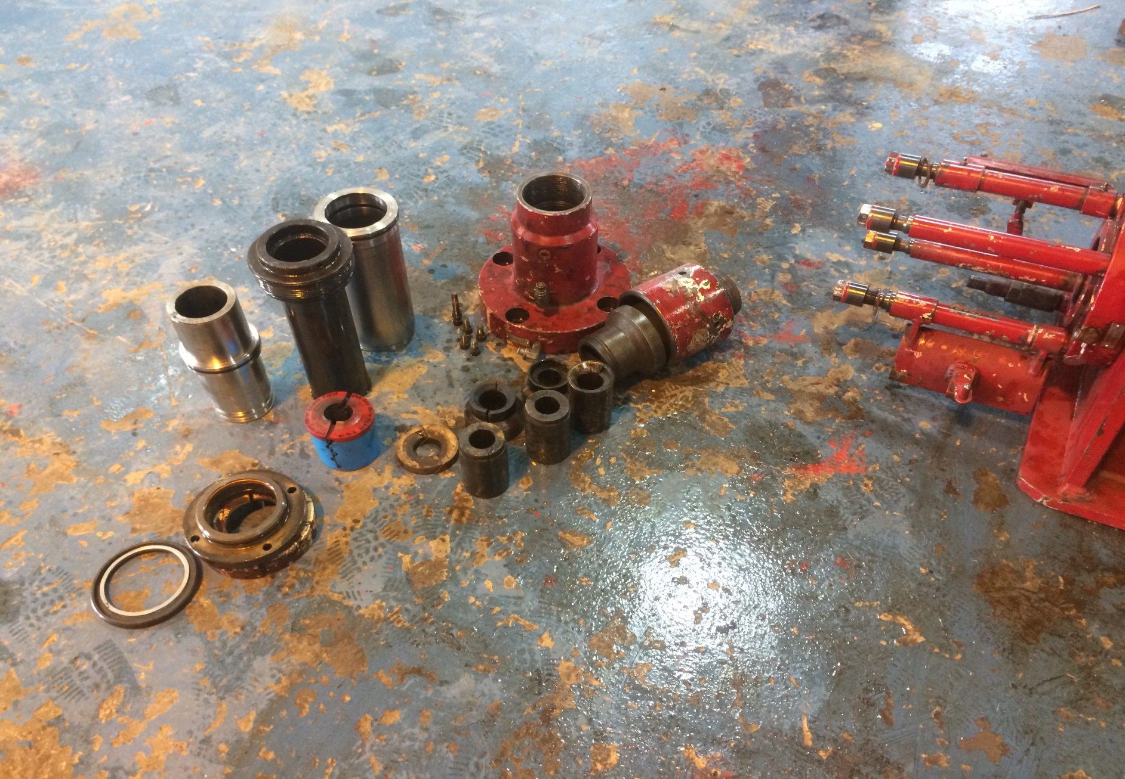
Main body
Packer cylinder
Bushing sleeve
Bottom sub
piston
Flange ring
Bushing guide
Washer-retainer
Packer interlock
Non-extrusion

Slide 19
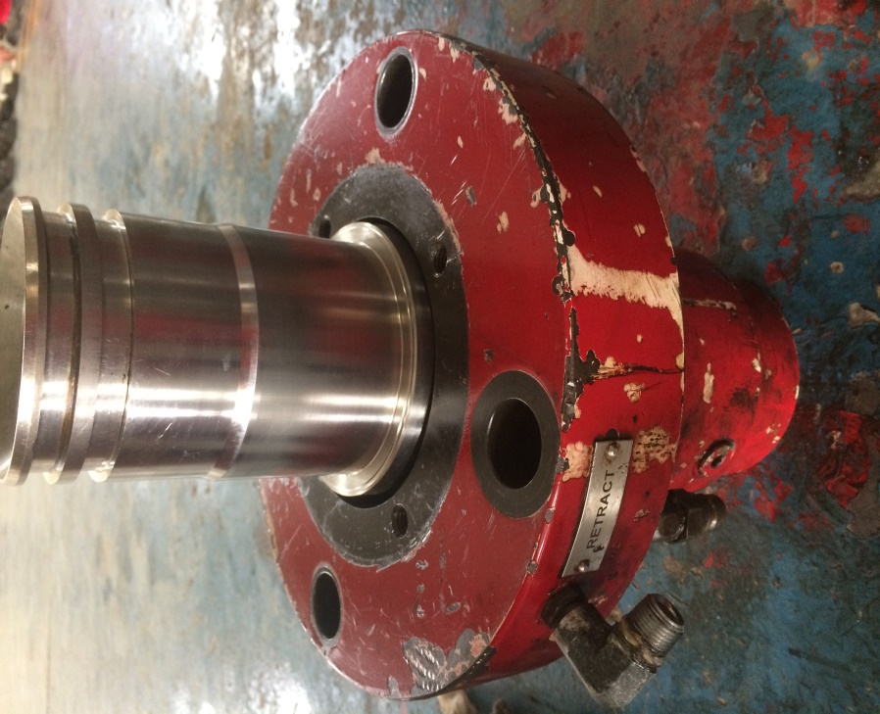
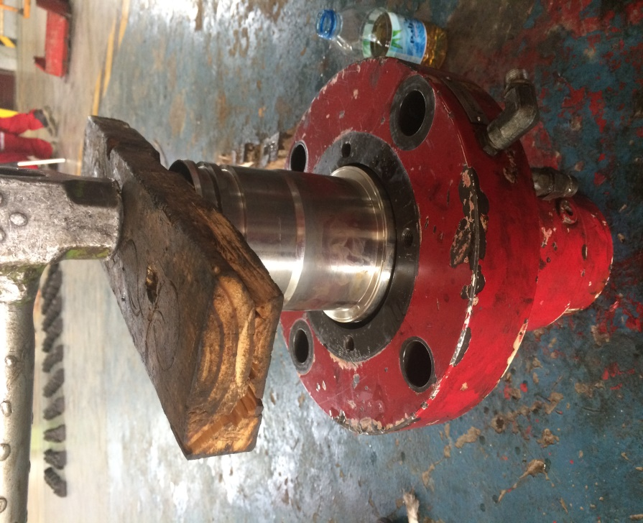
Assembly
1- Lubricate all parts before assembly. Install M-seal (19) on to piston(25). Note the thin edge of the seals must be installed toward the top of the tool. Install T-seal(32) on to piston(25). Note make sure both back-up rings are installed with seal. Install seals(24 and 23) into main body(29). Clamp main body(29) in a vise. Install piston (25) into body (29) with M-seal facing away from main body(29) .
A
B
piston

Slide 20
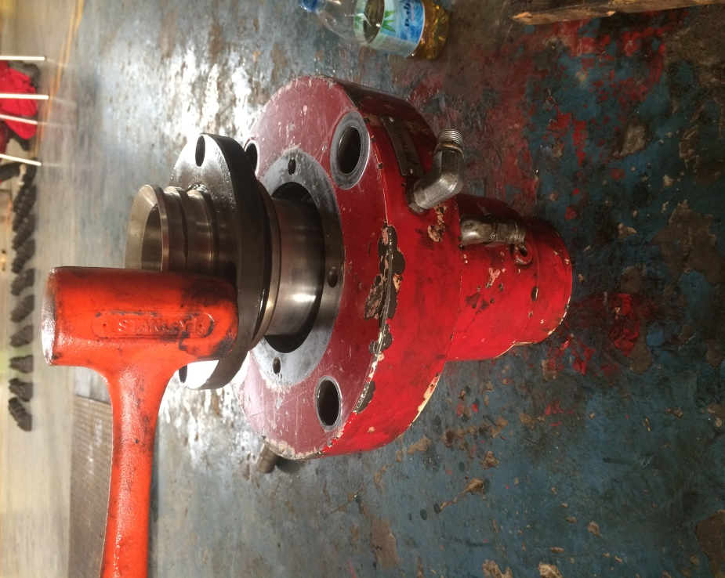
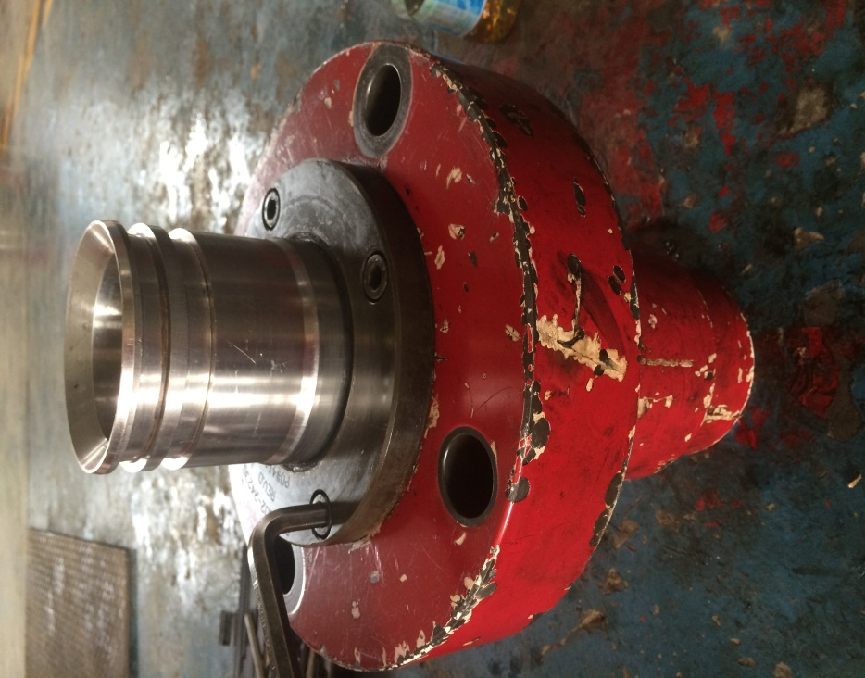
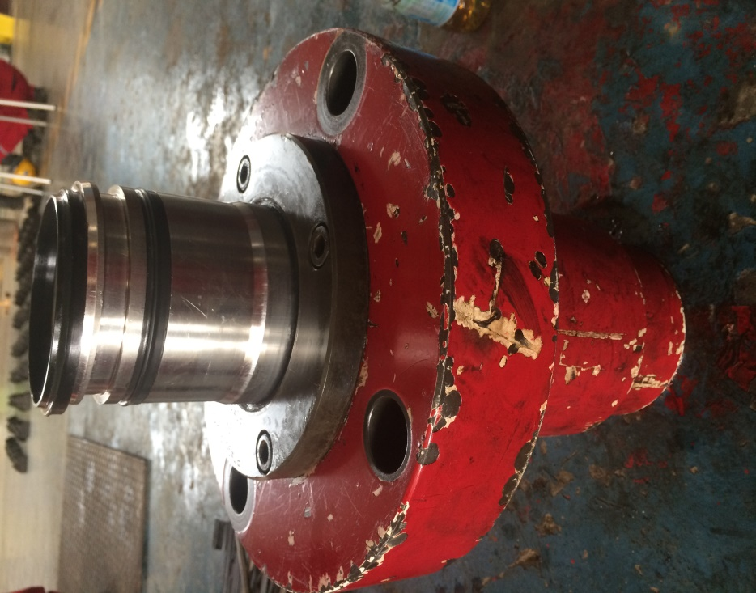
2- Install wiper ring(34) and seal(23) into cylinder head(22) . Install O-ring(33) on to cylinder head(22). Install cylinder head(22) in to main body(29). Install four socket head cap screws ½ (37) into cylinder head(22) and main body(29) , maximum torque 50 ft/lb . Install O-ring(28) into main body(29) . Install seals (19) .
A
B
C
piston

Slide 21
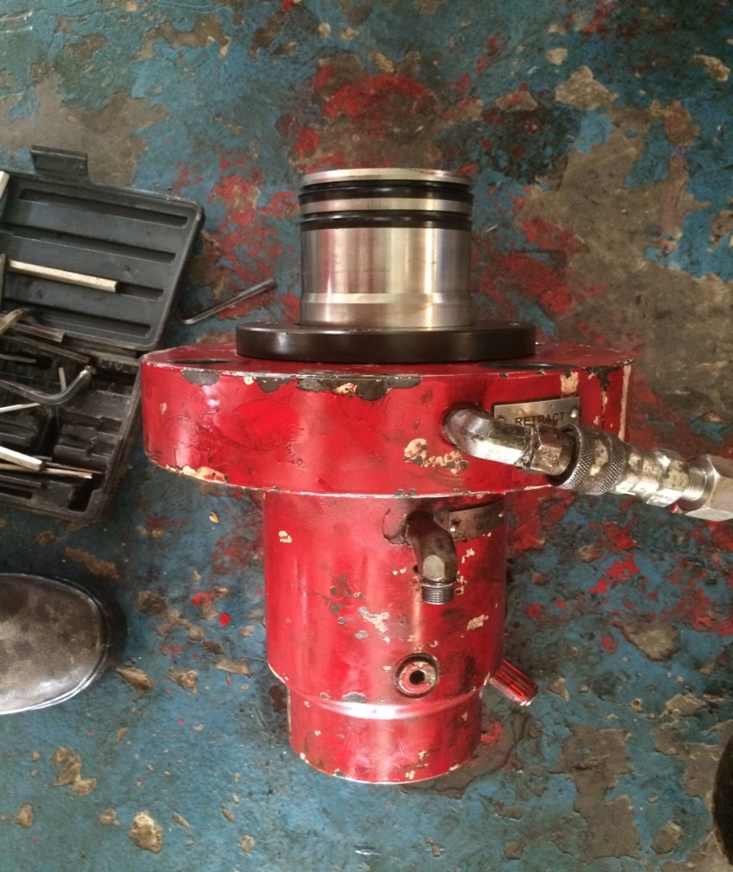
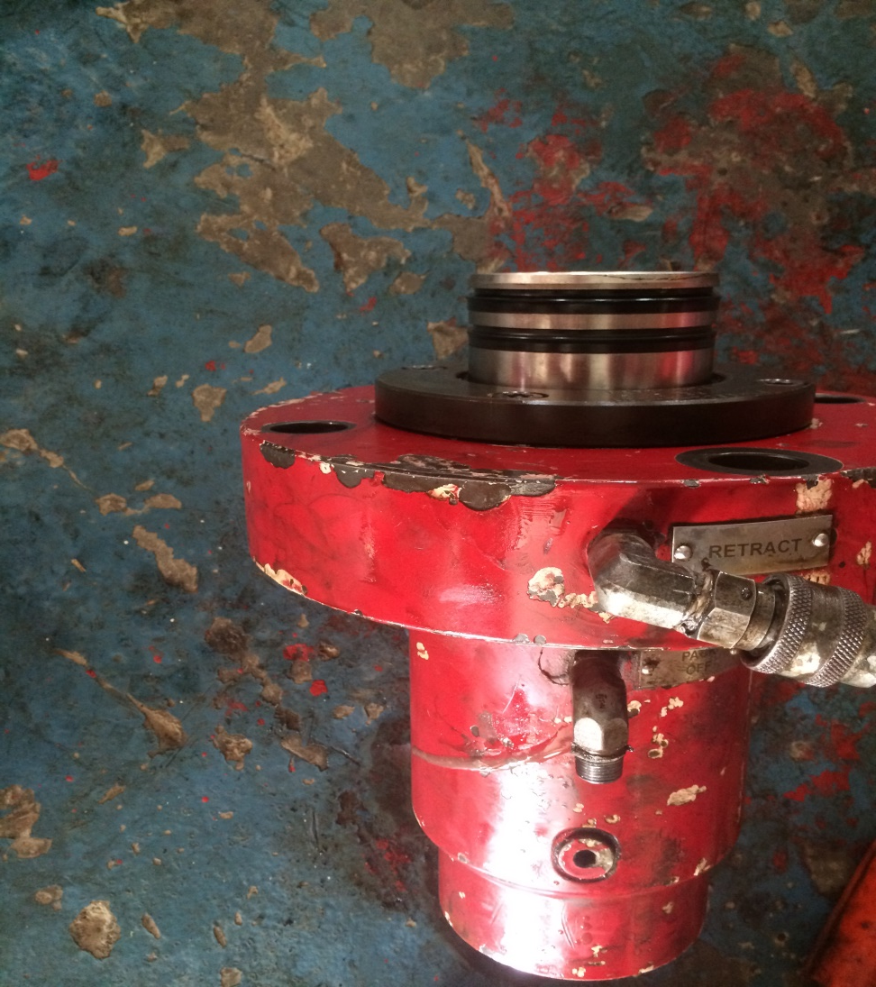
3- put back the piston(25) by pumping in retract by hydraulic hand pump.
A
B
Piston
Main body

Slide 22
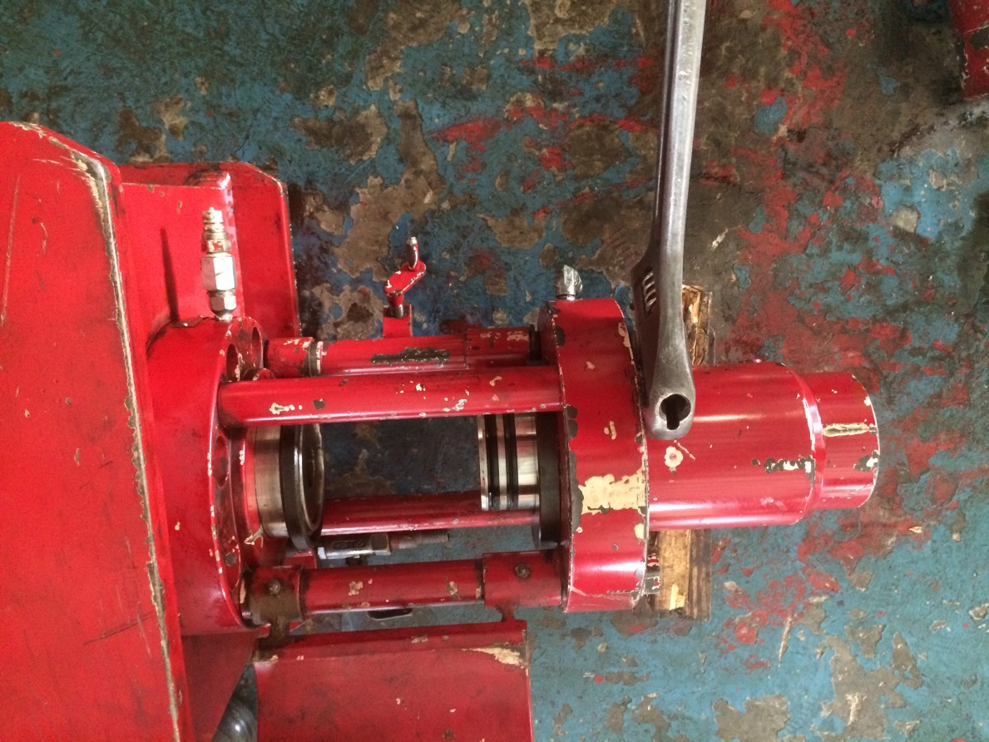
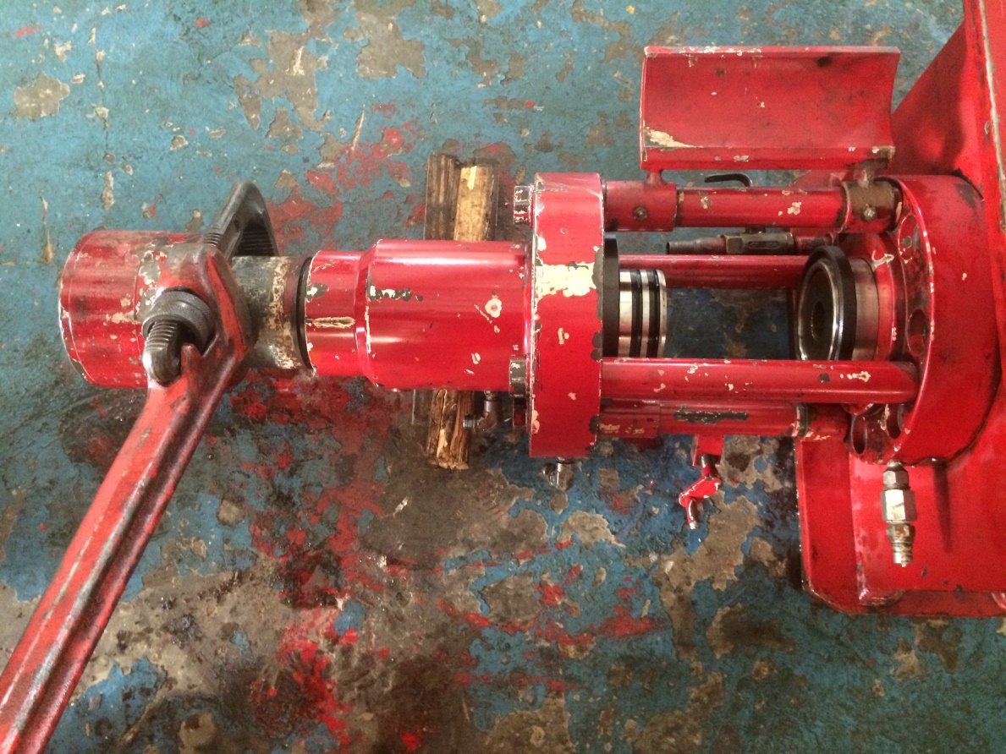
4- Install union nut(31) on to bottom sub(30). Install bottom sub(30) into main body(29). Install main body assembly on to a vertical stand, supported by union nut(31) and bottom sub (30) . Install four studs(39) and 2 guard door lock(15).
A
B

Slide 23
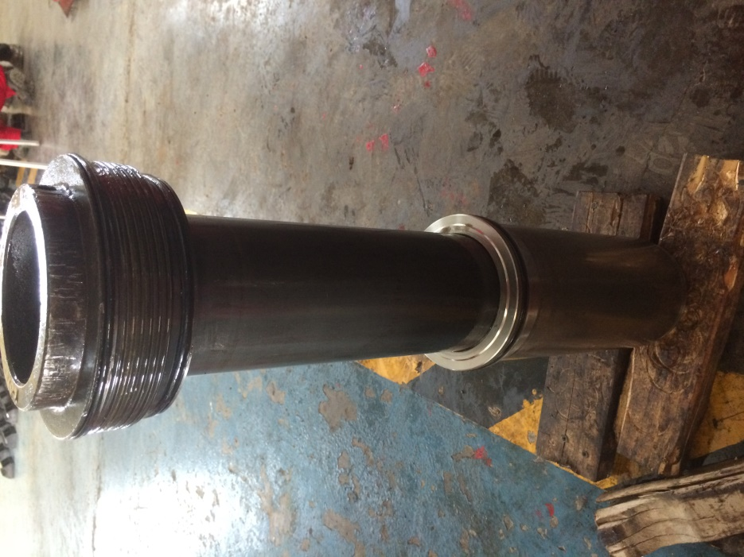
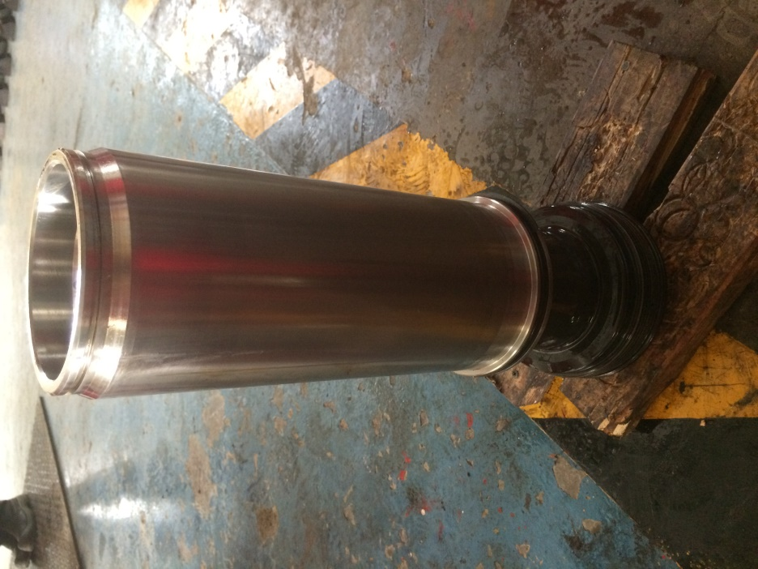
5- install seal(10) and T-seal(8) on to packer cylinder(7). Install packer cylinder(7) into upper hydraulic body(9). Push down packer cylinder one inch below upper hydraulic body(9) exposing ring groove . Install O-ring(3 and 4) on to bushing sleeve(6).install bushing sleeve(6) into upper hydraulic body(9) turning clockwise to set. Install split cap(2) on to upper hydraulic body(9). Install socket head cap screw ½ 91) into split cap (2).
A
B
push
Bushing sleeve
Packer cylinder

Slide 24
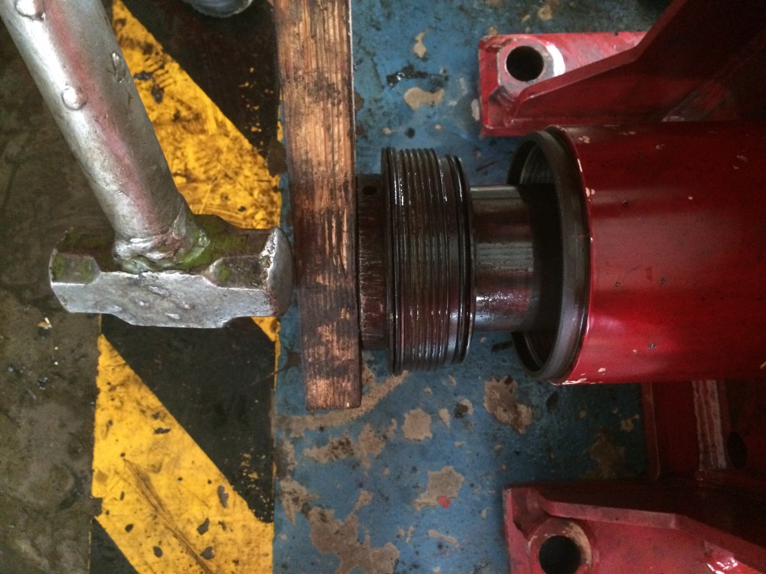
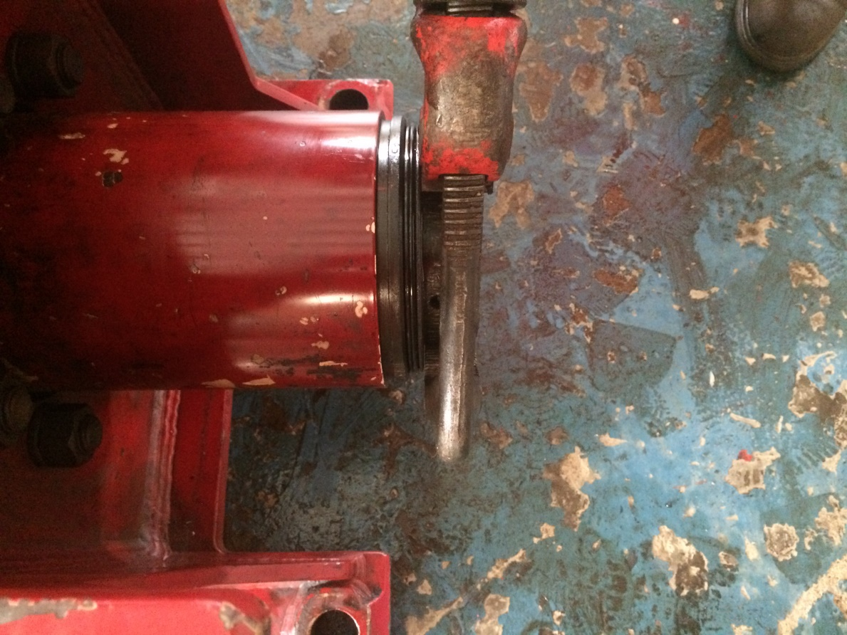
A
B

Slide 25
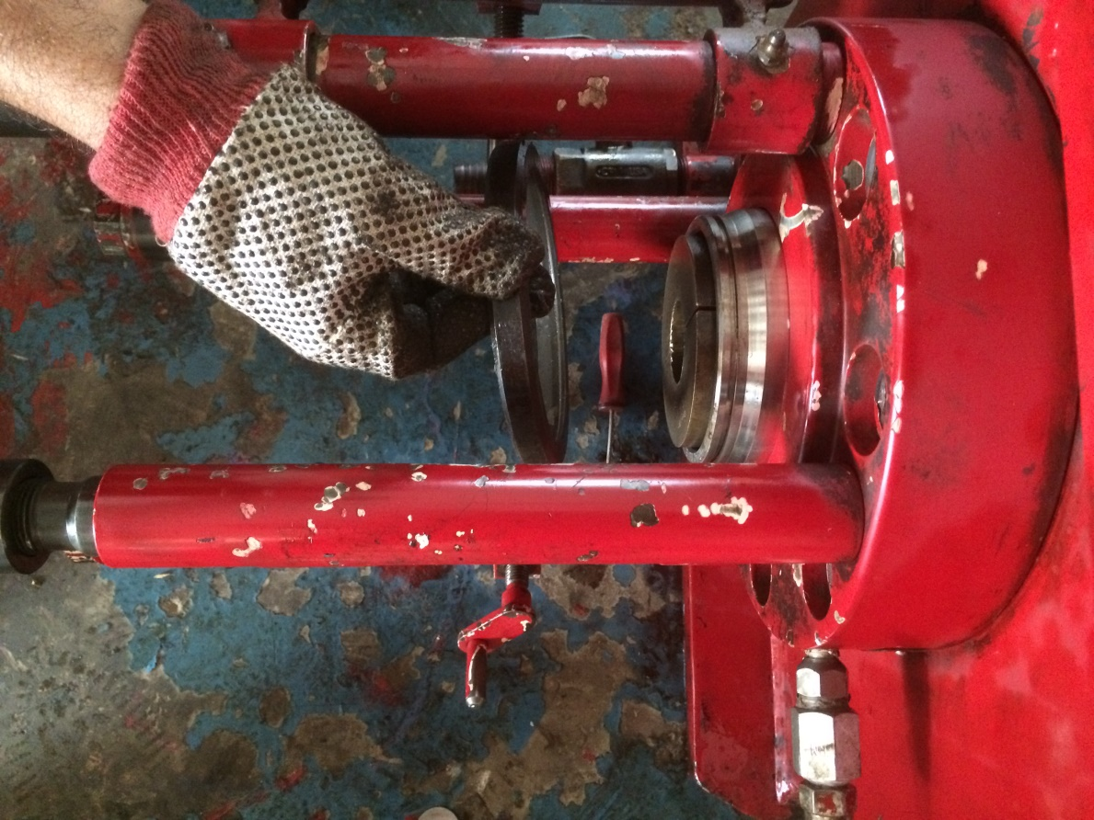
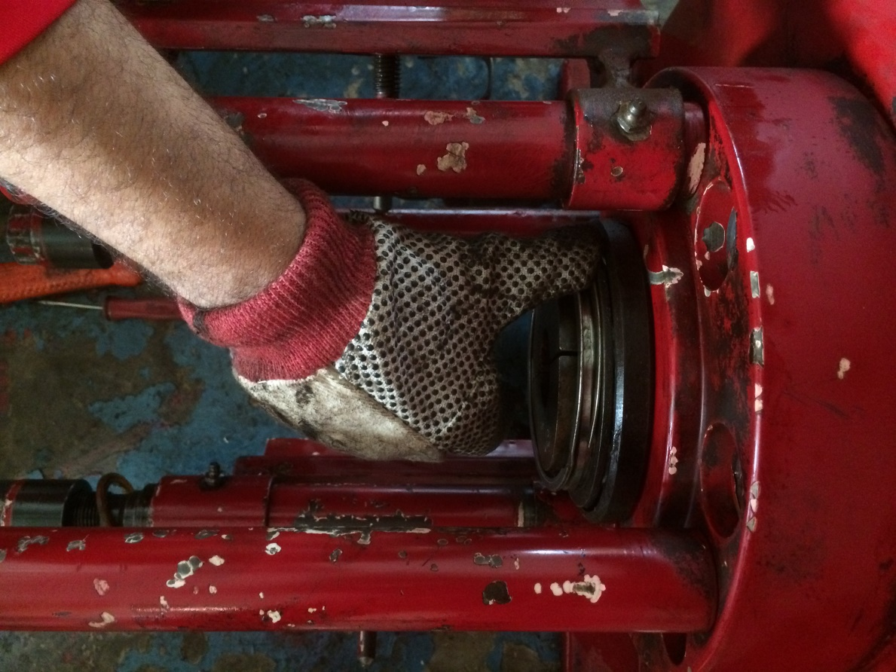
6- Assemble between upper hydraulic body (9) and Main body (29) as follows: Install flange ring (21), washer (20) and retainer ring (35) (in that order) on to packer cylinder (7). Locate retainer ring (35) in ring groove of packer cylinder (7). Install lower bushing packer (18) into piston (25) .
A
B

Slide 26
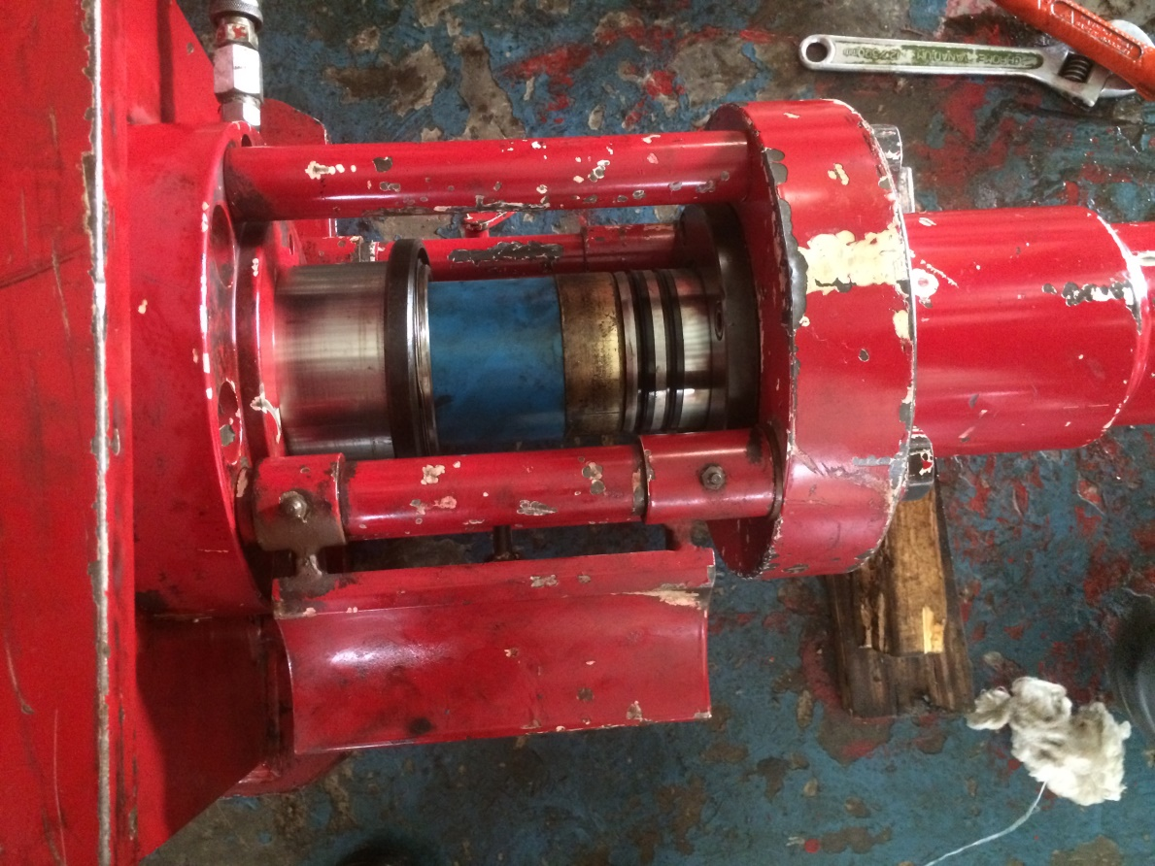
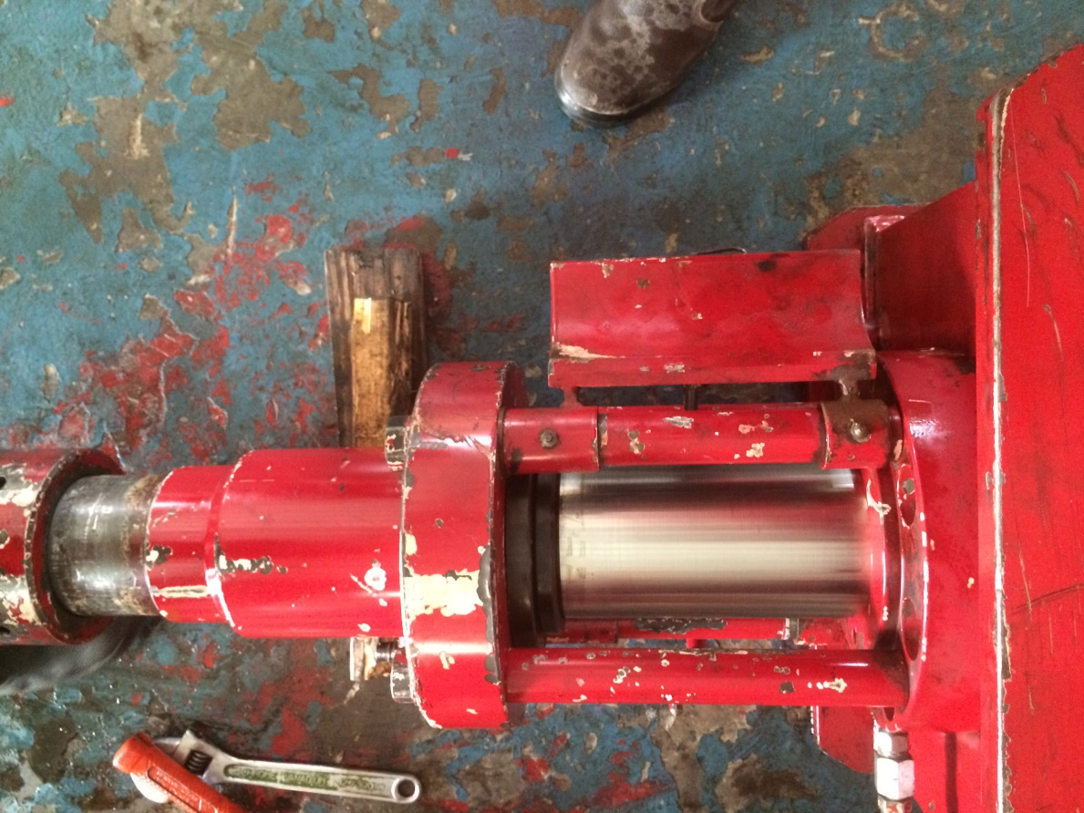
Install bushings (5, 42, & 41) through open window. The bushings are interlocking with the lower bushing locking into the bushing above it. The non-extrusion ring and the packers will be installed between bushings (18 & 41). The non-extrusion ring must be installed above the packer.
A
B

